Slide 1


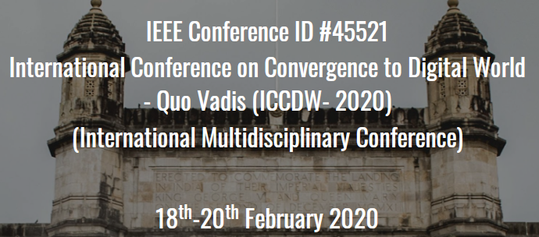
 | ATHARVA EDUCATIONAL TRUST'S ATHARVA COLLEGE OF ENGINEERING
 | (Approved by AICTE, Recognized by Government of Maharashtra & Affiliated to University of Mumbai - Estd. 1999 - 2000)
Paper Id / Submission Id :____
Paper id (easychair id): 90 | Authors Name : Karthikeyan, Uddhabendra Maity , Atharv Shetty, Prof. Vishal Badgujar, Dr. Sameer Nanivadekar
Institute Name: | A.P. Shah Institute of Technology
Presentation given by: | Uddhabendra Maity, Karthikeyan , Atharv Shetty
Paper Title: | Autonetics and Administration for IT Laboratories
PDFeXpID: | 6341533
2020, International Conference on Convergence to Digital World – Quo Vadis (ICCDW 2020)

Slide 2
PRESENTATION FLOW
Abstract
Problem Definition/ Objective
Introduction
Literature Survey
Theory (Proposed work/Implementation/Algorithm etc.)
Results and Discussions
Conclusion/Future Scope
References
Date: 20/02/2020
2020, International Conference on Convergence to Digital World – Quo Vadis (ICCDW 2020)

Slide 3
ABSTRACT
Majority of IT labs in today's academic institutions face operational issues in the management of multiple systems simultaneously. The best example would be when a particular software needs to be installed in the labs, it becomes a tedious and time consuming process for the lab assistant to manually install the software in each and every system in the lab.
Also in some cases where the students forget to shutdown their respective computers, it becomes the responsibility of the lab assistant to shutdown the PCs manually. These challenges cause lack of access control and inadequate security. Moreover, there is lot of work pressure which leads to sub-optimal work schedules. To keep track of access records of the systems, we would also be designing a web-based GUI which records and displays the access information of PCs too.

Slide 4
PROBLEM DEFINITION
In current university labs most of the administrative tasks are done manually which consumes lot of time and efforts. With the help of ansible framework and a proper supporting GUI, we can unleash and maximize the full potential of the servers and many of the current lab administrative problems can be resolved easily.
The major drawback of the existing environements in the university labs is that its completely restricted within the scope of the lab instructors.Our architecture aims in automated installation and management of software packages.
Ansible is originally only a command-line interface tool and thus it lacks an elegant user interface. Only a well versed user will be able to operate on a command line tool, which means a layman user will find it difficult to operate and run operational tasks effectively.

Slide 5
INTRODUCTION
As we are using a free and open-source platform for our purpose, many labs can be automated using the same architecture at a very feasible price.
Ansible provides the automation of IT infrastructure which includes – creation of virtualmachine, installation of new softwares, Docker containers
We can configure our own cluster and make it up and running without any sort of human intervention. Ansible does its work like a professional if customized with proper facts and experience.
Ansible works over SSH ensure that the target Machine or Server is accessible over SSH. It supports all type of SSH authentication.

Slide 6
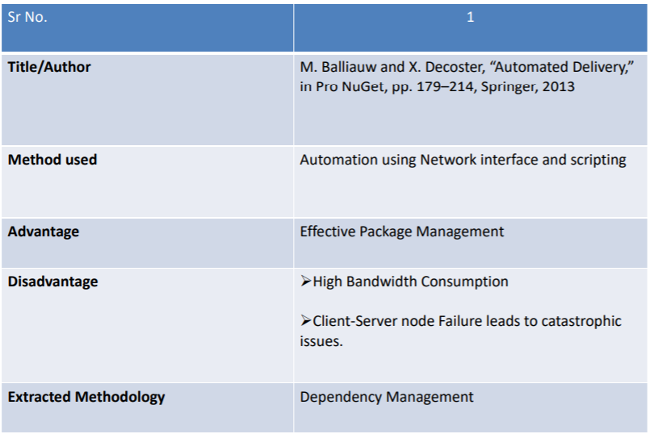
LITERATURE SURVEY

Slide 7
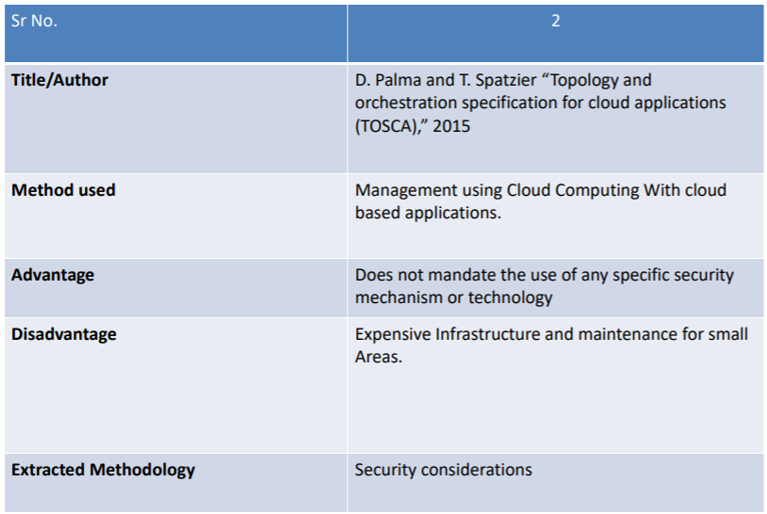

Slide 8
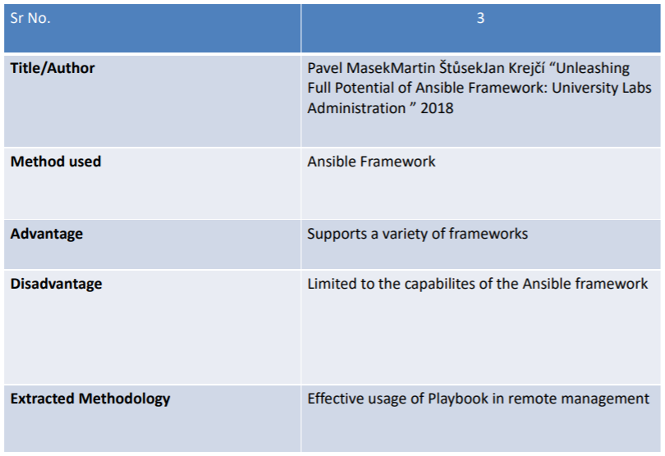

Slide 9
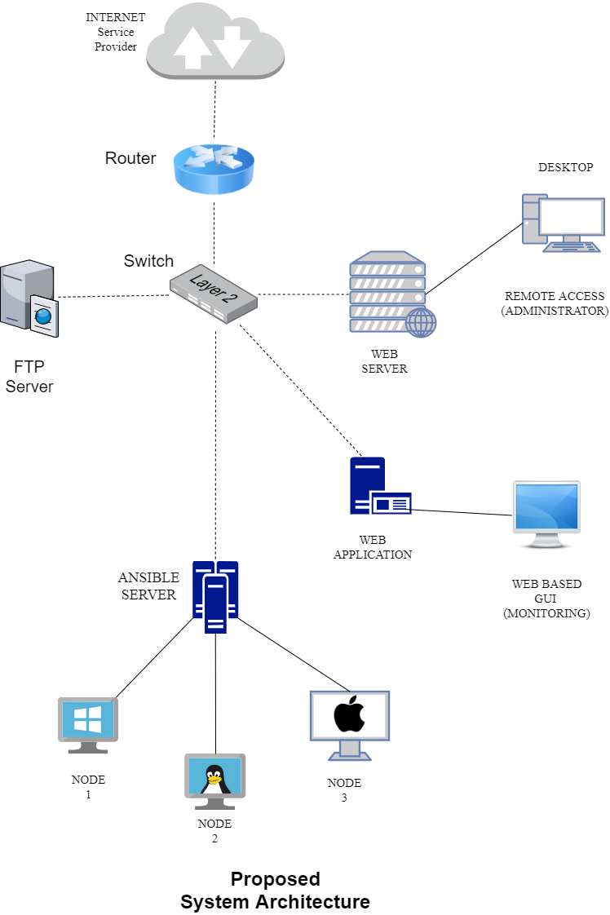
PROPOSED ARCHITECTURE

Slide 10
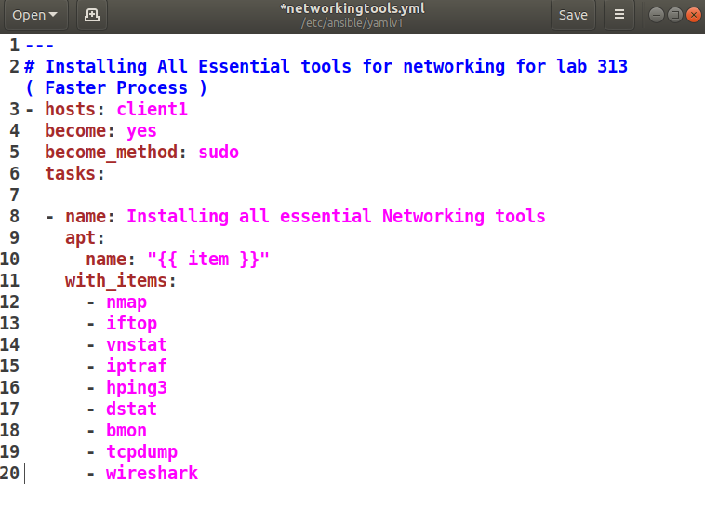
IMPLEMENTATION
Sample playbook for installing the essential set of tools for networking in a college Lab infrastructure

Slide 11
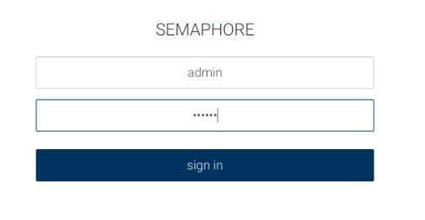
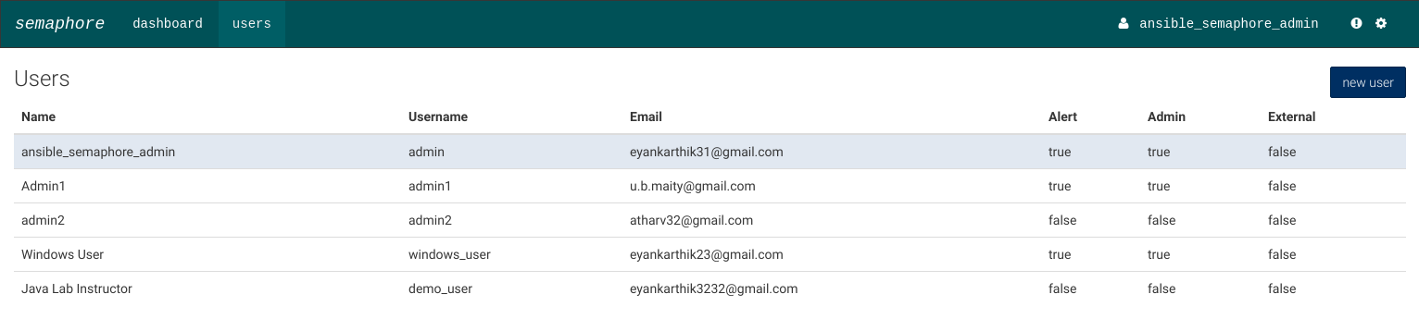
Ansible login GUI for LAB instructors
User Manager for Admins

Slide 12
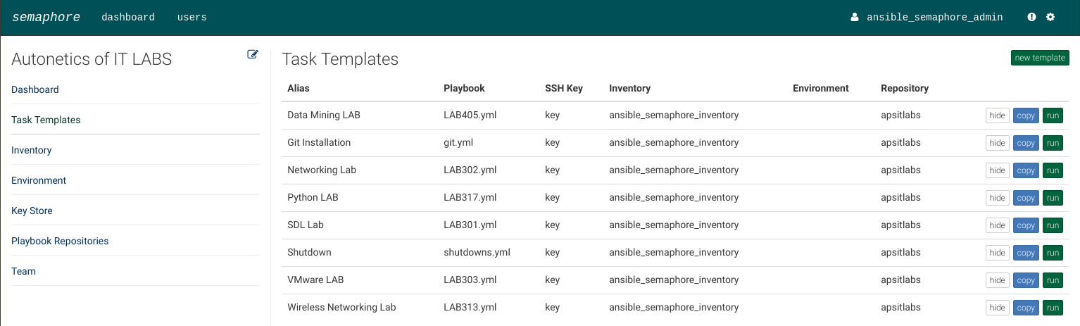
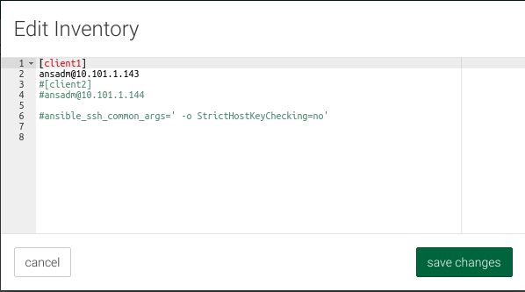
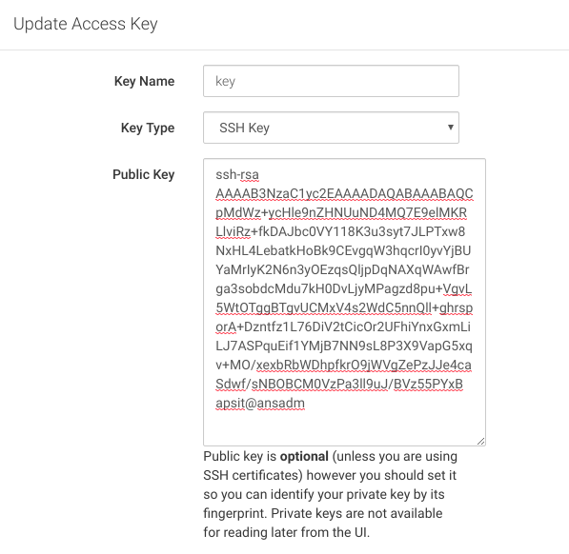
Playbooks for different LABS
Inventory file
SSH access keys

Slide 13
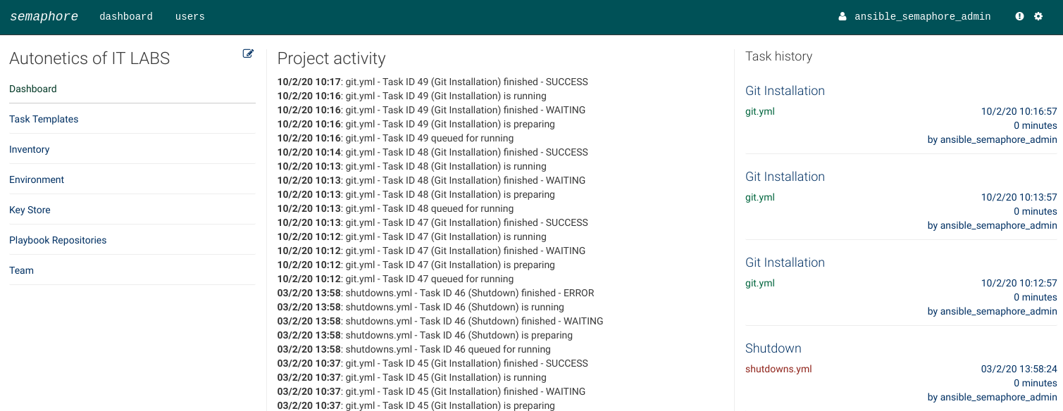
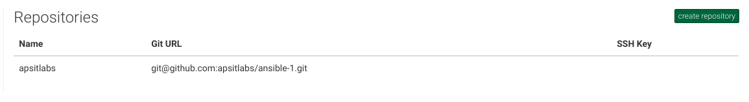
Realtime Log generation
Fetching from Github Repository

Slide 14
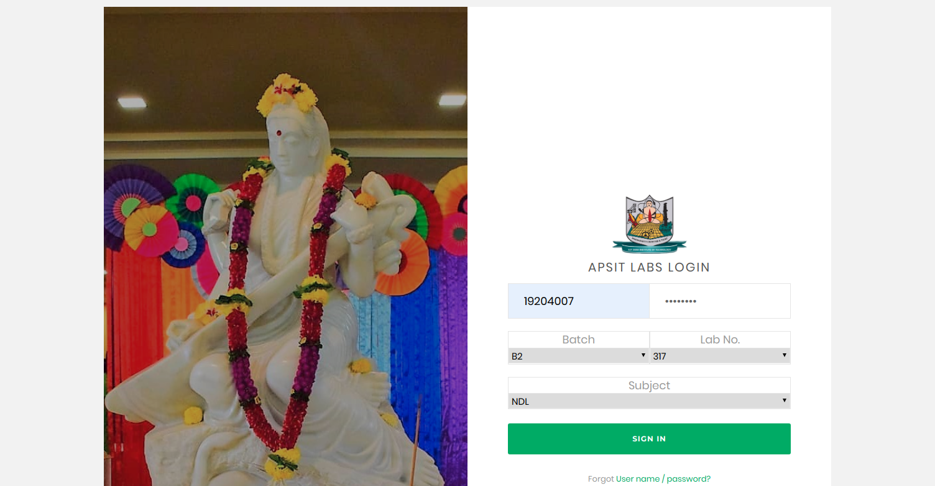
Student Lab Utilization Record

Slide 15
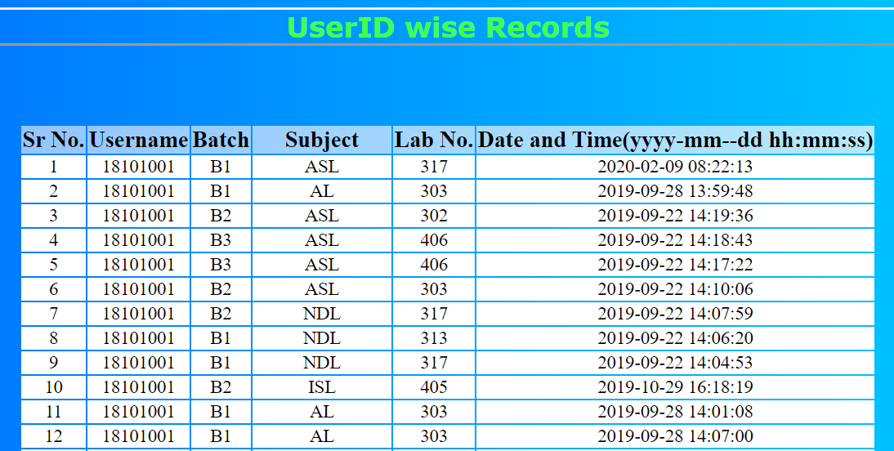
Centralized monitoring of lab utilization logs

Slide 16
CONCLUSION
The main motive of our work is to create a trustworthy, efficient and real-time system for administration of IT labs in universities. Now all the administrative tasks inside the lab can be executed at a very minimal time and effort with our system. The overall purpose was to minimize the efforts and ensure rapid deliveries of the needed softwares through automation. These objectives have been checked successfully and we hope to enhance the system furthermore and increase the advancements in our system. Thus we are making an effort to implement this system in the current university labs and modernize the IT labs methodically.

Slide 17
FUTURE SCOPE
Integration of IOT : We plan to inetegrate IOT interfaces in our system for controlling all the electrical applicances throughout the lab remotely.
Using Docker containers for easy deployment of applications in real time
Enhancing the Security : Providing real time log generation to the system administrators for moderating the student's usage during exams or placements.

Slide 18
REFERENCES
[1] Xavier Decoster and Maarten Balliauw“Automated Delivery in Pro Nuget” October 2016.
[2] D.Palma and T.Spatzier. December 2016 “Topology and orchestration specification for cloud applications (TOSCA) ” November 2013
[3] Pavel MasekMartin and ŠtůsekJan Krejčí, “Unleashing Full Potential of ansible Framework: University Labs Administration” May 2018
[4] Nishant Kumar Singh , Amity University, “Automated Provisioning of Application” January 2016
[5] J.O.Benson, J. J. Prevost, P. Rad, “Survey of automated software deployment for computational and engineering research,” in System Conference (Sys Con), 2016 Annual IEEE, pp.1–6, IEEE, 2016.

